Slide 1

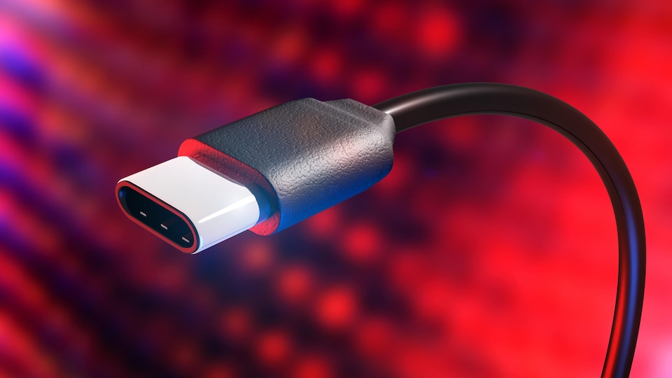
Usb 4

Slide 2

INTRODUCTION
Usb 1.
Usb evolution.
Thunderbolt.
Advantage of Usb.
Usb.
New usb (Usb 4.2).
Difference between Usb 3.2 and 4.
Connectic.
Conclusion.

Slide 3


USB 1
Quickly Adopted in 1996

Slide 4
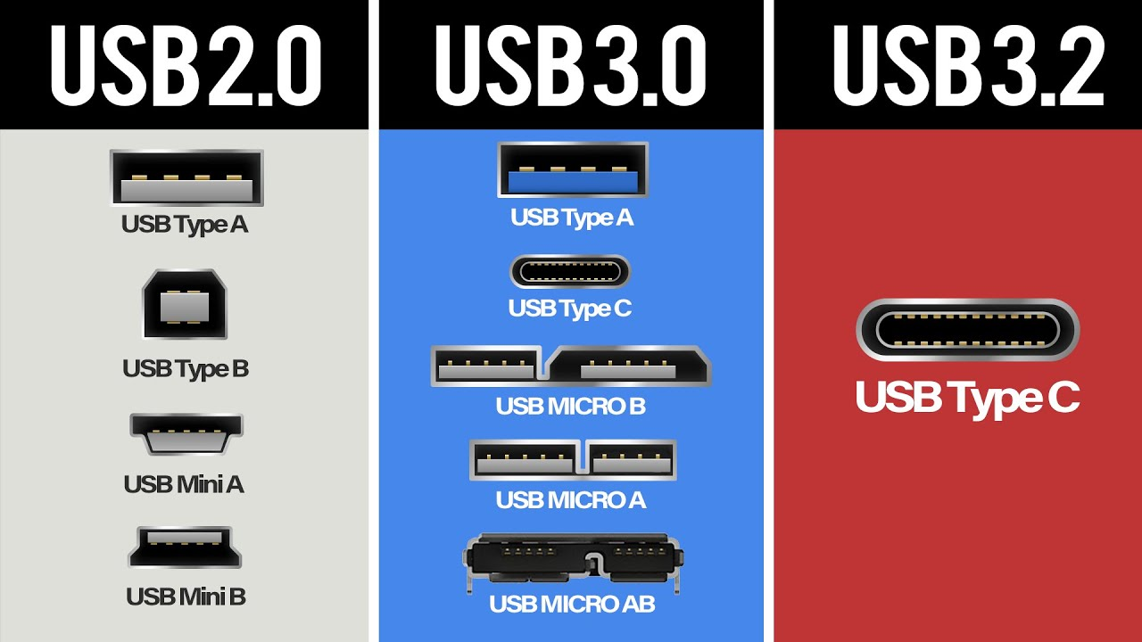
USB EVOLUTION

Slide 5
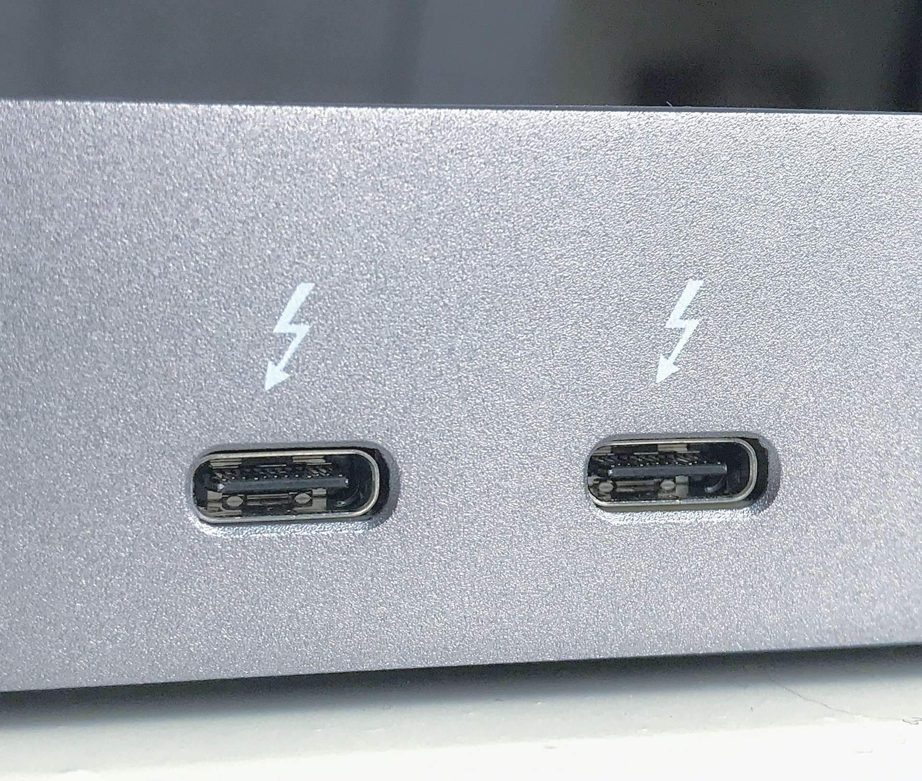
Thunderbolt

Slide 6
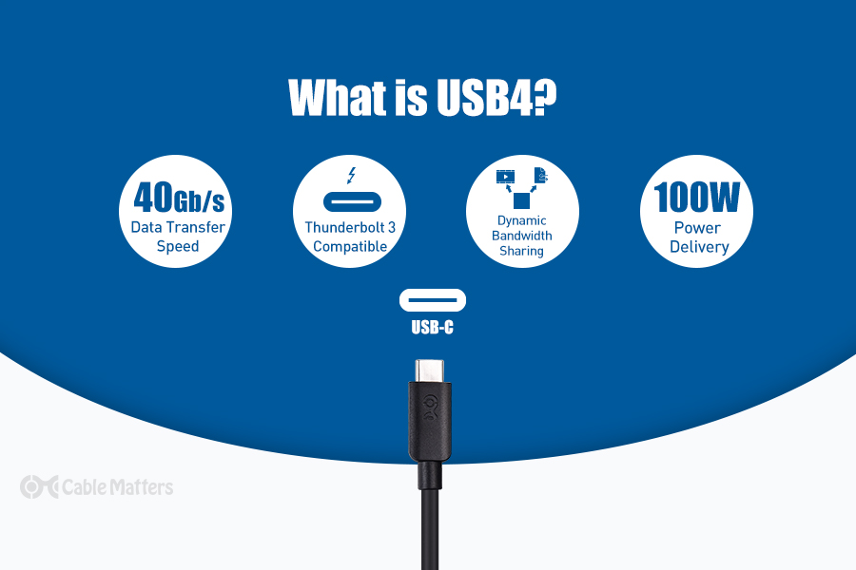
Advantage of USB

Slide 7
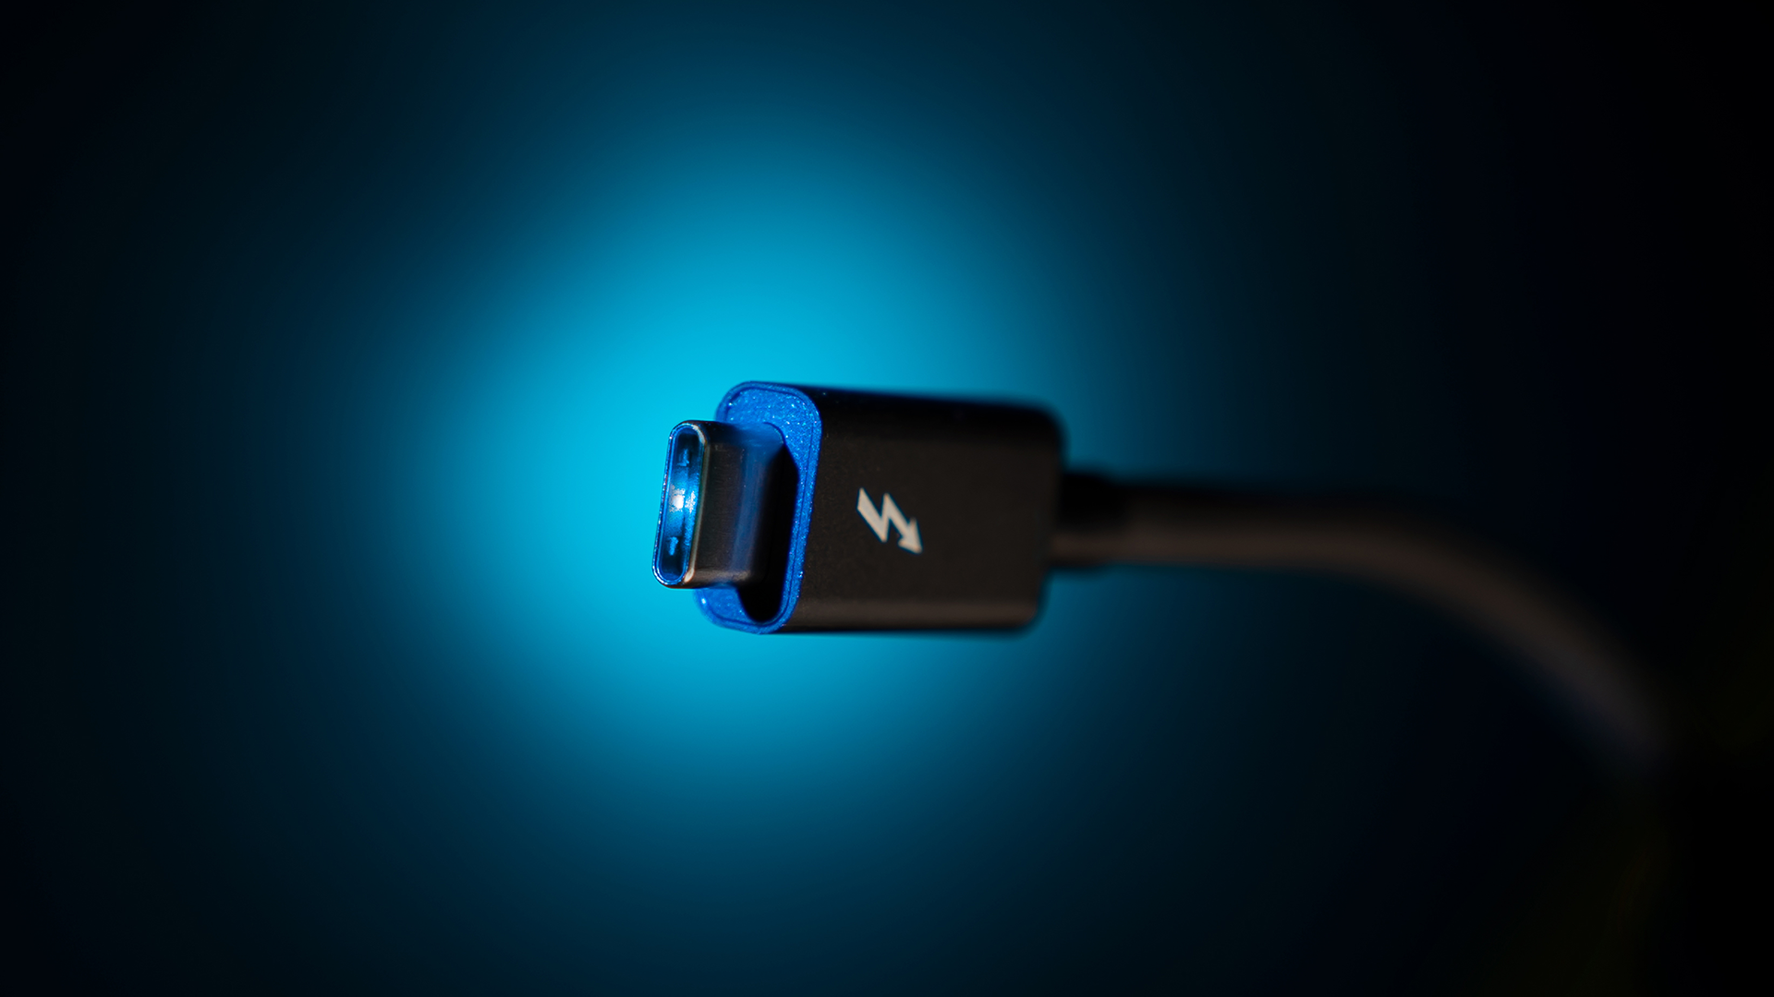
NEW USB
Usb 4.2

Slide 8
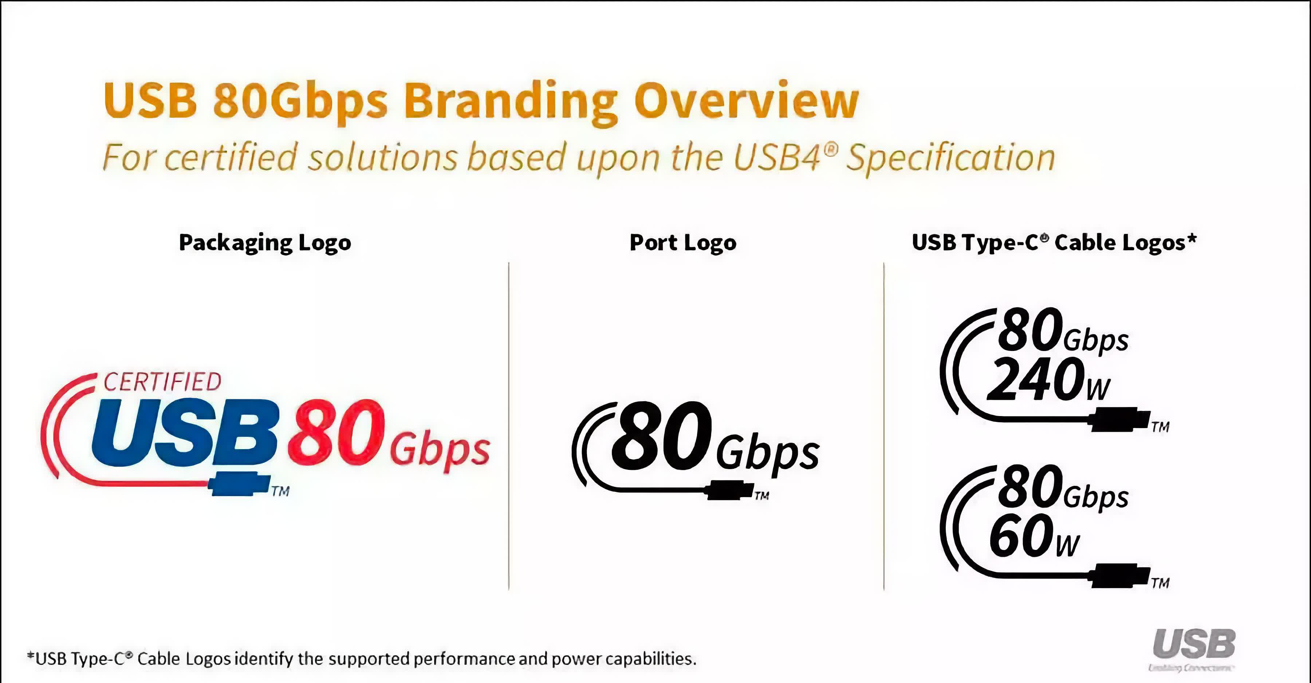
USB 4.2

Slide 9
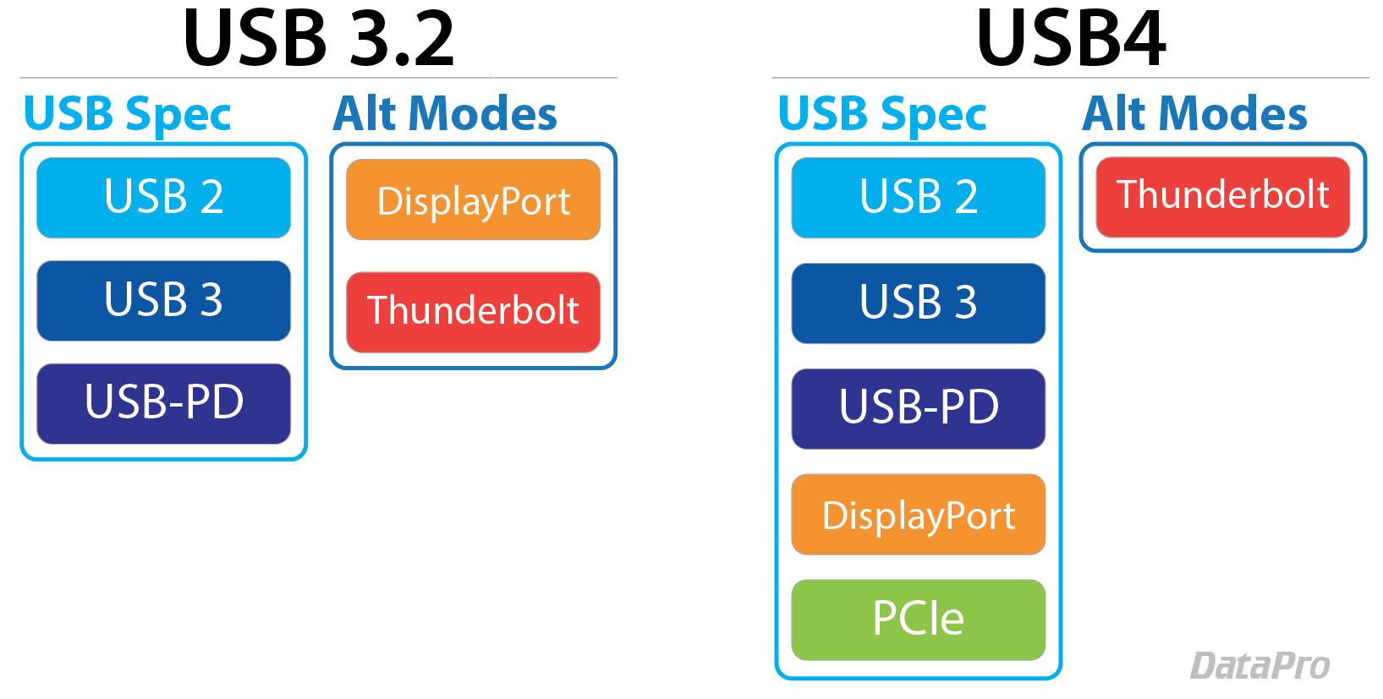
Difference USB 3.2 AND USB 4

Slide 10
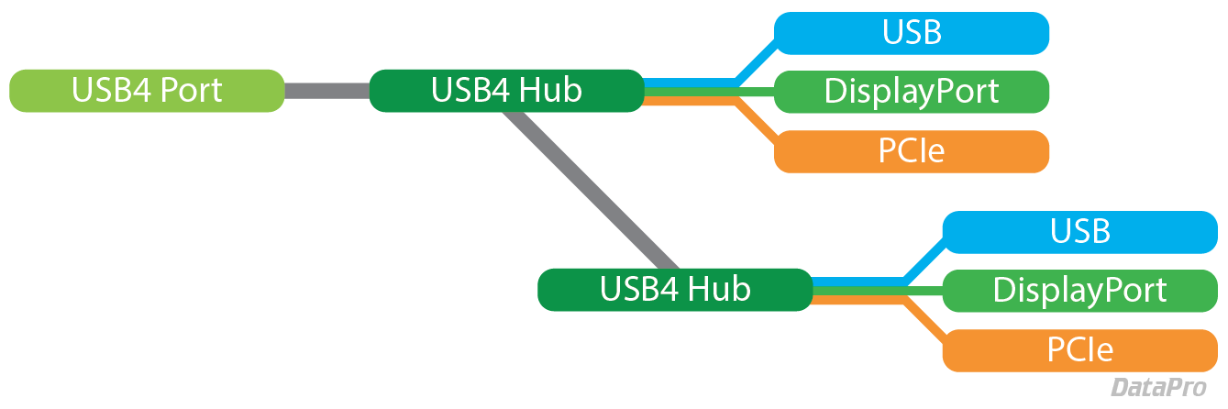
USB CONNECT

Slide 11
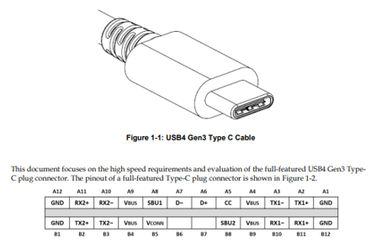
Connectic

Slide 12

Conclusion and point of view

Slide 13


Thanks for your attention

